Slide 1
Shared, High-Performance Software Components for Shared, High-Performance Hardware
Xiaosong Ma
Qatar Computing Research Institute
Sep 2022

Slide 2
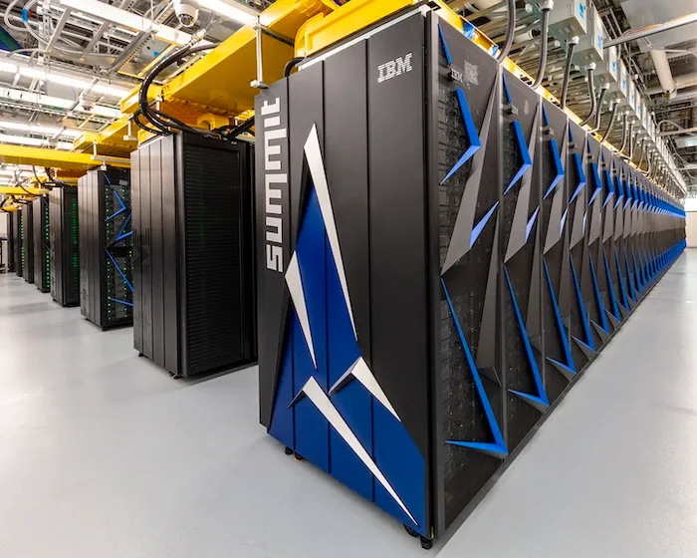
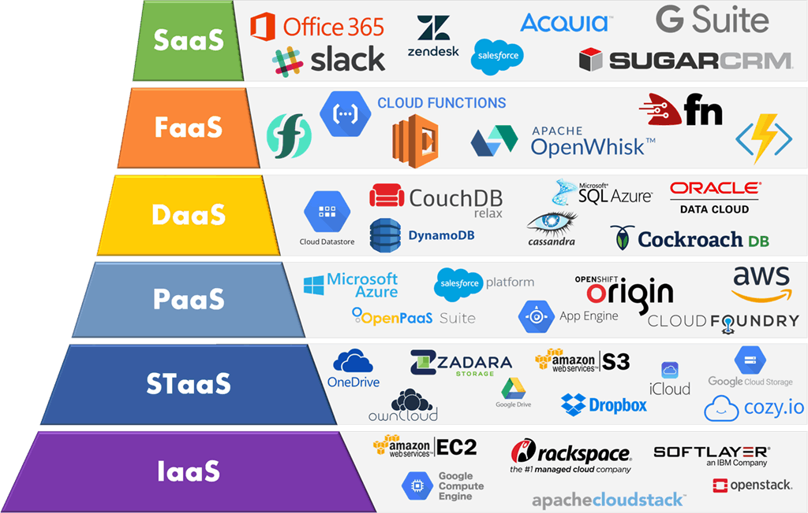
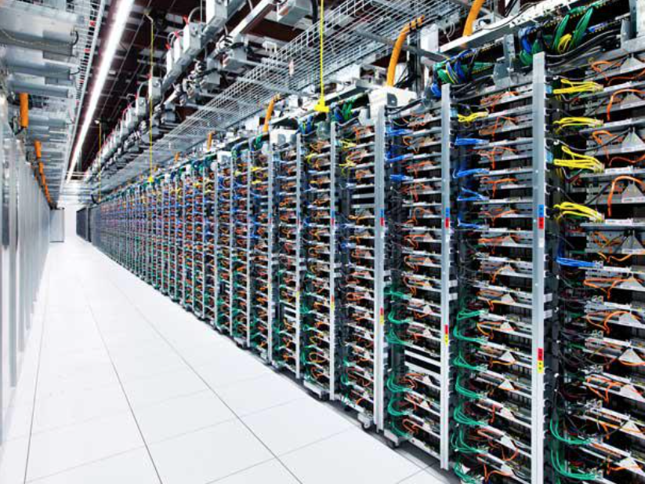
World of Shared Computing Resources
Supercomputers
Source: Oak Ridge National Lab
Data centers
Source: https://www.crn.com/news/data-center/google-unveils-new-750m-data-center-as-part-of-9-5b-goal
Cloud platforms and services
Source: https://kinsta.com/blog/google-cloud-vs-aws/

Slide 3
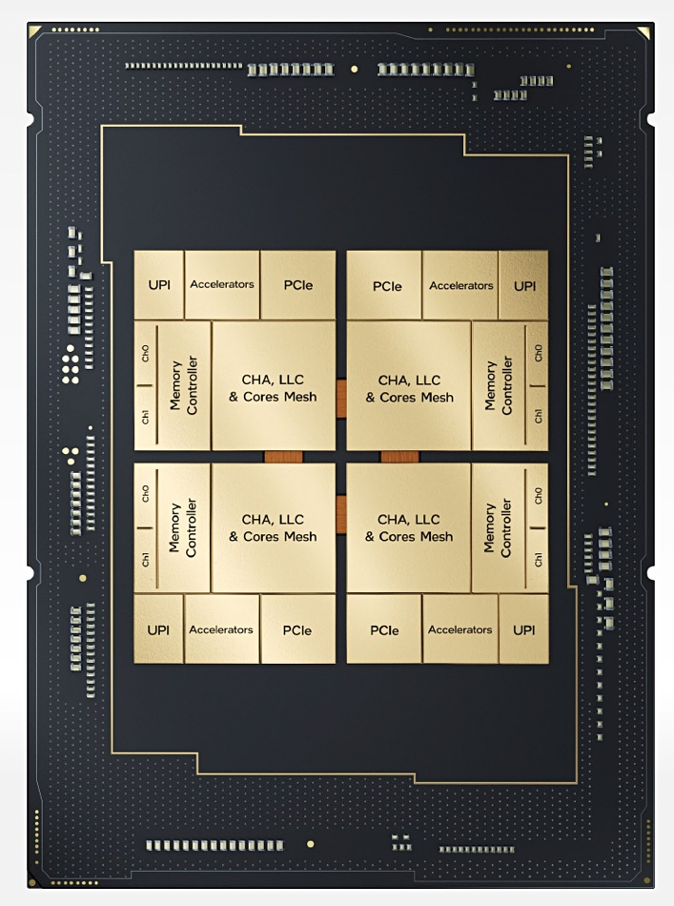
Hardware Trends for Shared Platforms
Multi-core processors
Dozens of cores
CPU caches optimized for multi-tenancy (e.g., large L2 caches)
TBs of DRAM space
Mechanisms for inter-core resource allocation (cache ways, memory BW)
Powerful interconnect
Fast network connections (e.g., up to 100Gbps at AWS)
Smart NICs/DPUs offloading computation tasks
High-capacity storage
NVMe SSDs offering space, bandwidth, and IOPS for sharing
Intel Sapphire Rapids: 56 cores, 2MB L2 cache/core
Source: Intel

Slide 4
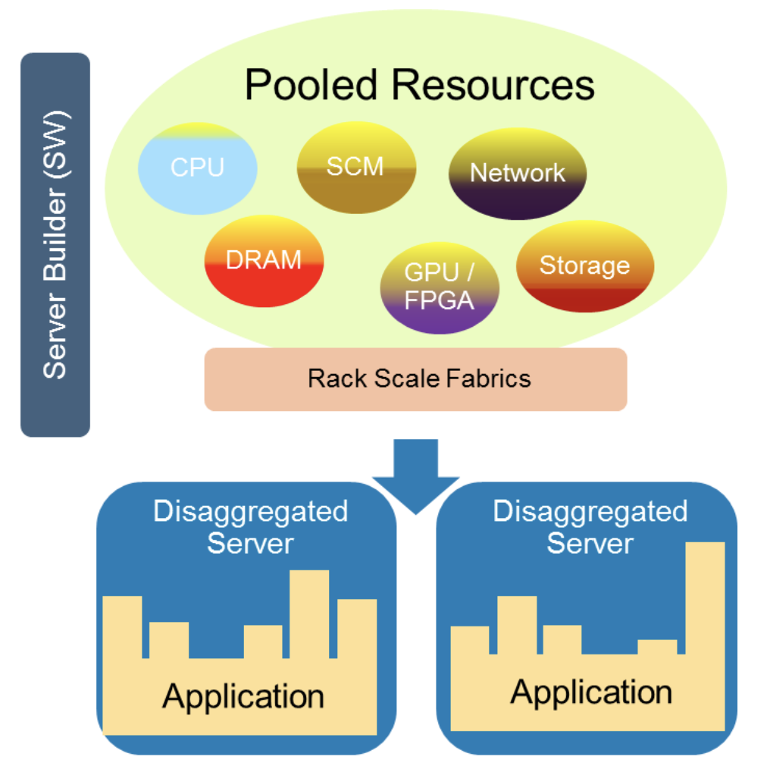
Software Trends for Shared Platforms
Virtualization
Mature VM and container technologies
From CPU to GPU and DPU
Software defined storage/networking
More control and flexibility
Resource disaggregation
Pooling individual resources to be independently allocated: CPU, DRAM, storage, network …
Cloud-native services and serverless computing
Service components dynamically deployed
Server disaggregation
Source: Dell

Slide 5
Implications of Pervasive Resource Sharing
Programs to run
on unknown/changing hardware
with unknown/changing neighbors
Major challenge: performance portability
Desirable for applications/services to
retain (optimized) performance across platforms
achieve hardware potential

Slide 6
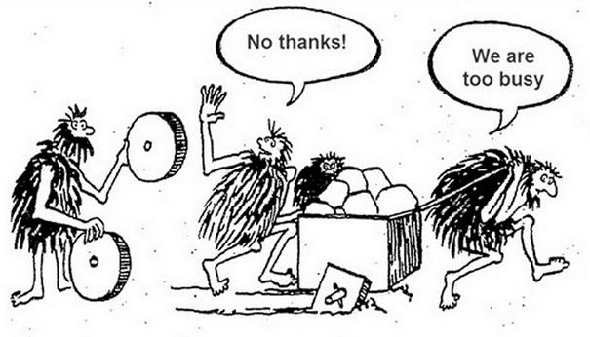
Needed: Shared Software Components
To save cost of repetitive, inefficient development

Slide 7
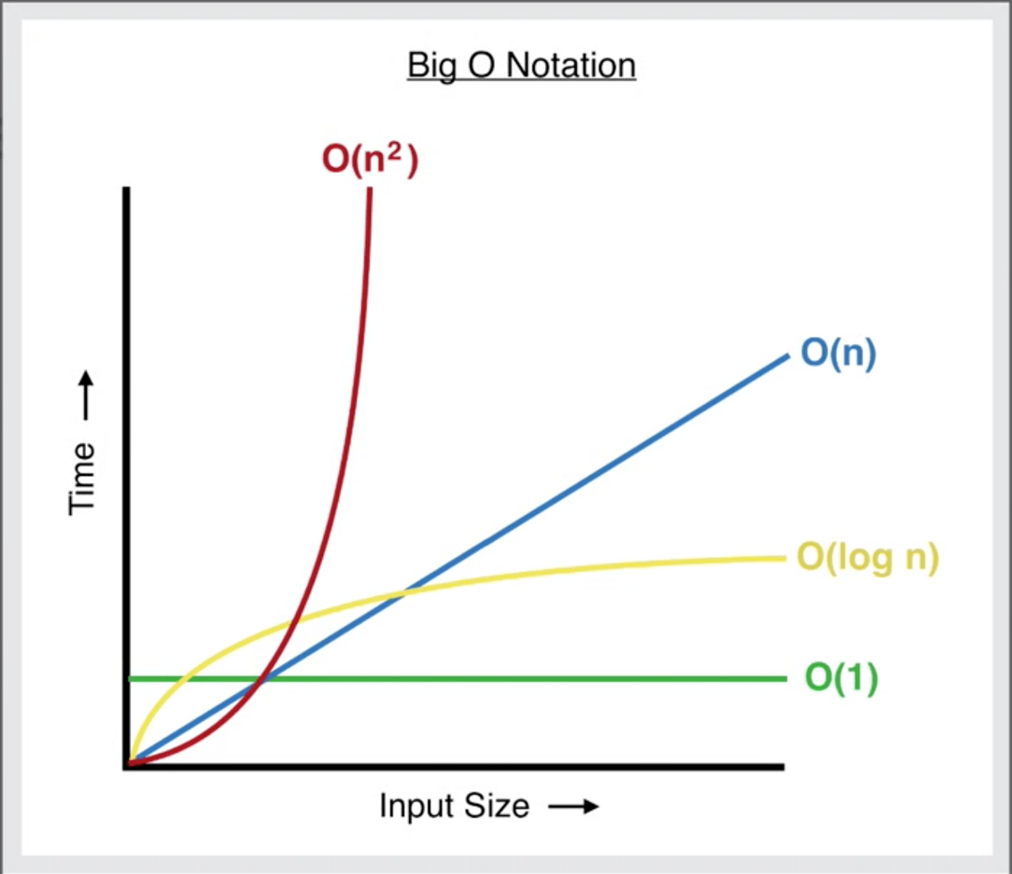
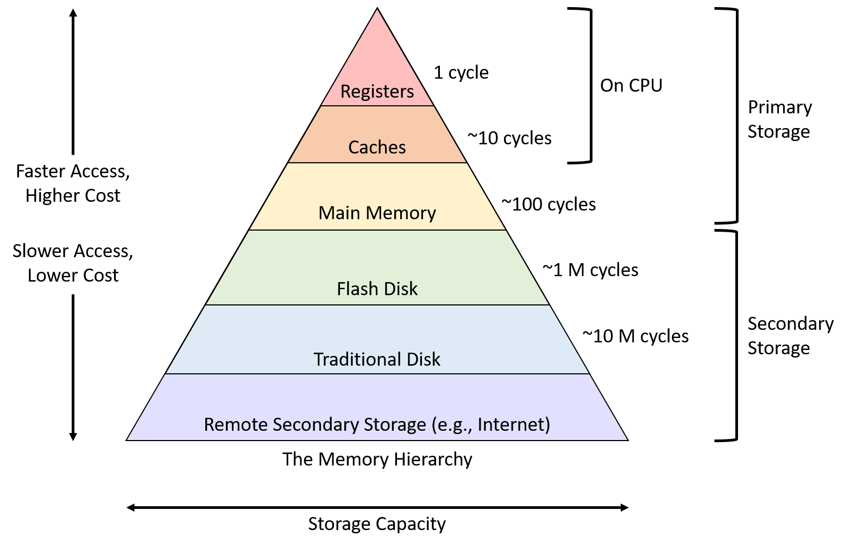
Challenge Lies in Storage Hierarchy
Computation logic more “portable”
Instruction execution easier in scheduling and isolation
Current server processors w. sizable per-core resources (e.g., L1+L2 cache)
Data access path deeper and more complex
Larger, cheaper, slower, less random-friendly
(https://medium.com/dataseries/a-quick-primer-on-big-o-notation-c99ccc7ddbae)
(https://diveintosystems.org/book/C11-MemHierarchy/mem_hierarchy.html)

Slide 8
Challenge 1: Flexible Partitioning of Storage Layers
Private
Shared cache
Mature on-demand
provisioning on cloud (Space, BW, IOPS)

Slide 9
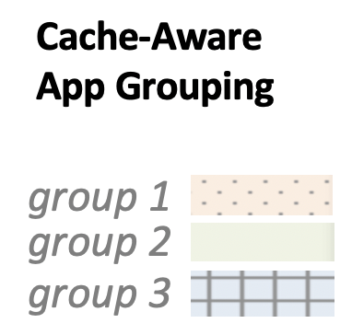
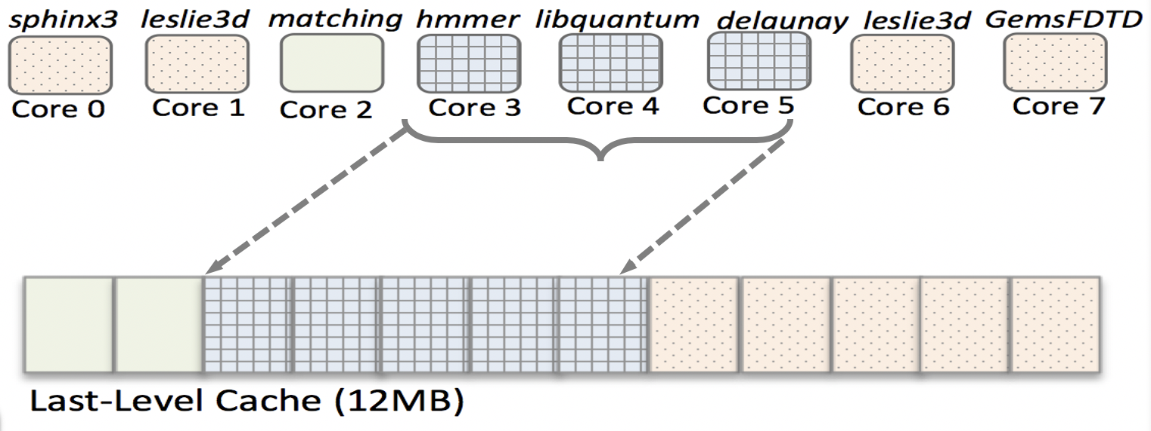
Related Study 1: Cache Partitioning in Commodity Multicores
✔ Recent processors offer hardware cache-partitioning support (Intel CAT)
Partitioning last-level cache among co-running apps
reduces interference ➔ improves system performance
Kpart [HPCA ‘18], w. MIT
✖ Two key challenges limit usability of CAT
Current hardware implements coarse-grained way-partitioning ➔ hurts system performance!
Lacks hardware monitoring units to collect cache-profiling data
Solution: hybrid way partitioning and sharing among app groups
Significant performance gain on real hardware (avg 24%, max 79%)

Slide 10
Related Study 2: Spread-N-Share Cluster Scheduling
SNS [Supercomputing ‘19], w. Tsinghua U.
Existing batch scheduling minimizes job footprint
Use as few nodes as possible
Problem: self-contention on critical resources
SNS: promoting co-location of parallel jobs
Scaling out resource-bound jobs to alleviate bottleneck
Using resource-aware job placement
Focus on cache capacity and memory bandwidth
Results: simultaneously improved job performance and cluster utilization
SNS Components
SNS Scheduler
SNS Database
SNS Daemon
SNS Profiler
SNS Actuator
Job 0
Job 1
Job 2
CPU cores
LLC ways
Memory bandwidth

Slide 11
“Storage Container” All the Way
Private

Slide 12
Challenge 2: Achieving Hardware Potential
L3 Cache
4 ways
DRAM
256GB,
2GB/s BW
Given resource partition
How to fully utilize storage hierarchy
For given task/service
How to configure resource partition
NVMe SSD
2TB, 500k IOPS
SATA SSD/HDD
1TB,
1GB/s BW
Network storage
2TB

Slide 13
Sample Memory/Cache Performance
Location | L1 cache | L2 cache | L3 cache | Local mem | Remote mem
Sequential read | 0.42ns | 0.41ns | 0.44ns | 0.76ns | 1.51ns
Random Read | 0.77ns | 0.95ns | 2.60ns | 18.35ns | 24.35ns
Pointer-chasing | 1.69ns | 5.26ns | 19.26ns | 116.90ns | 194.26ns
4-byte read latency at different cache/DRAM layers
Sequential reads quite cheap, and relatively uniform
Even across NUMA node (remote memory)
Random reads slower, with wider distribution
Large gap between L3 and DRAM
Pointer-chasing especially costly: even in L3

Slide 14
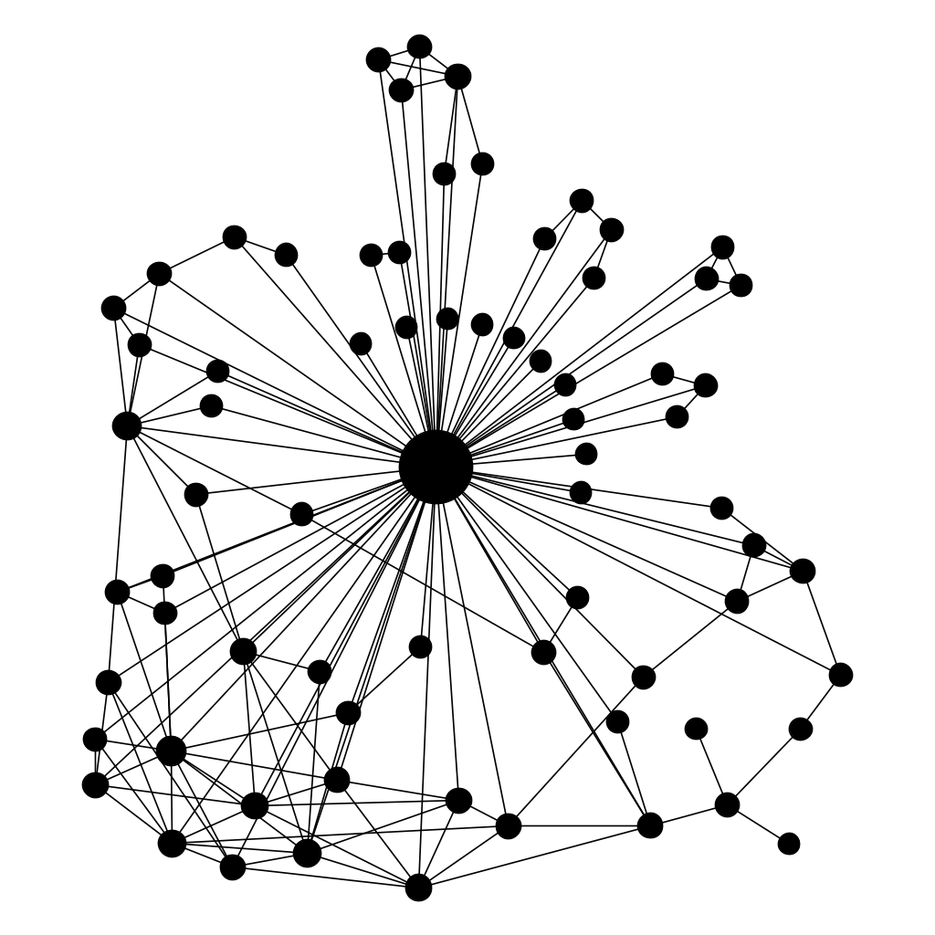
Case Study 1: Graph Random Walk Engine
Problem definition
Input: graph, set of walkers placed at starting vertices
Each walker walks around
By randomly selecting an edge to follow
For given number of steps or till given termination condition
Output
Computation during walk, and/or
Set of walk paths
…

Slide 15
Increasing Significance, Wide Application
Random-walk-based algorithms
Random walk adopters
DeepWalk
node2vec
SimRank
GraphSage
Personalized PageRank
…
Random walk applications
Sub-graph sampling
Epidemics study
Link prediction
Compromised device detection
…
Graph DL/GNN
Fake news mitigation
KnightKing graph random walk engine [SOSP ’21], w. Tsinghua U.
…
Web ranking
15
Notes:
So graph random walk is an intuitive way of extracting information from graphs.
And with the growth of graph data, it’s been gaining significance.
# First, it is a common method for graph embedding, these days a crucial step to prepare graph data for machine learning.
# It’s also used in graph neural network, which directly operates on graph structure.
It can be used for other tasks such as graph sampling, a building block of many graph-based analytics.
In year 2020 alone, over 1700 papers were published on graph random walk, at venues led by top conferences such as ICLR and KDD.
# In industry, graph random walk is routinely used by many companies. And listed here are just tech companies, while it’s also used by, for example, pharmaceutical and financial industries. Therefore it makes a good candidate to work as a shared software component.
# We made a step toward that by developing KnightKing, the first graph random walk engine, with details given in our SOSP paper.

Slide 16
Challenges: Slow Random Memory Accesses
Walkers make random choices
Following only one edge
Problem with existing solutions
Accept randomness in memory accesses
Process walkers in turn, wherever they are
High data dependency (pointer chasing)
Low utilization of loaded cache lines
Random walk doesn’t mean random memory accesses
Plenty of temporal and spatial locality around!
Rest of cacheline discarded
Sample 1 edge
Location | L1 cache | L2 cache | L3 cache | Local mem | Remote mem
Sequential read | 0.42ns | 0.41ns | 0.44ns | 0.76ns | 1.51ns
Random Read | 0.77ns | 0.95ns | 2.60ns | 18.35ns | 24.35ns
Pointer-chasing | 1.69ns | 5.26ns | 19.26ns | 116.90ns | 194.26ns
Edge list
Access latency at different cache/DRAM layers
Notes:
# The major challenge here is the random accesses dominating the graph random walk computation. With common graph processing tasks, such as BFS or shortest path, an active vertex usually traverses all its edges in one iteration. Random walks, however, follow a random, single edge at a time.
# Prior systems, therefore, took these random accesses for granted and happily accept the performance when we can fit the graph into the main memory or find a way to stream it if not. The common design is to process walkers in turn, wherever they are. # In this example, the green walker is at this vertex, # with 3 edges. # It throws a dice and picks one, # then updates its location to its new stop. # Same thing for the other walkers. This leads to two things. - First, there is high data dependency, so not only the accesses are random, we suffer from pointer chasing.
# Second, every time data are brought into the cache, we have the entire cacheline, whose common size of 64 bytes can hold 16 edges. With computation scheduled by walkers, it’s highly unlikely any of the other 15 edges get to be used before the cacheline is evicted, so most of the contents brought into cache are wasted.
# If we come back to this latency table, with earlier random walk implementations, including our own KnightKing in SOSP19, # the major memory access types are exactly the undesirable cases.
# In this work, we found that random walk doesn’t imply random memory accesses! And we shouldn’t settle for DRAM performance. Actually, there are plenty of temporal and spatial locality, if we look carefully enough.

Slide 17
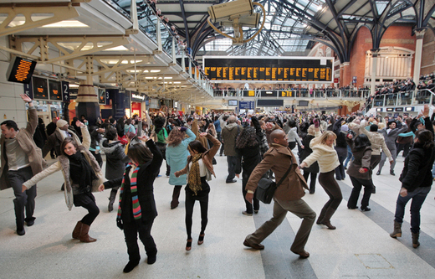
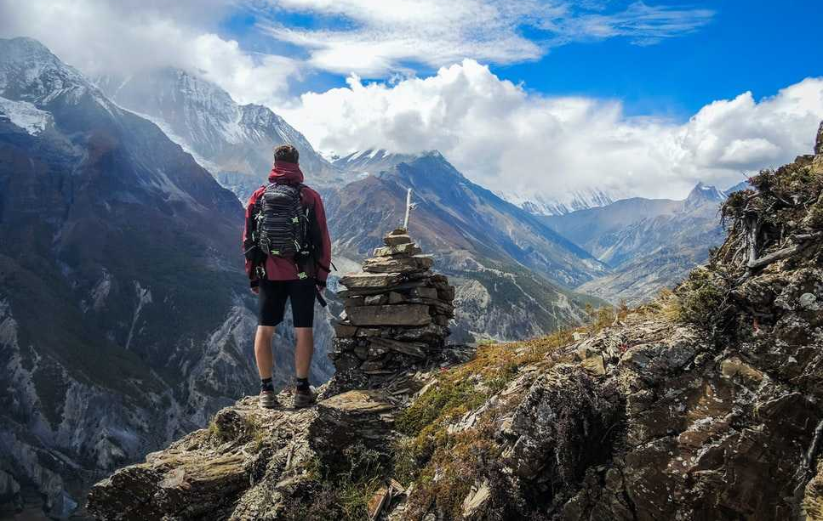
Key Insight: Vertices Not Equal
2048
Highly variable degrees
(Max over 7.6 million)
512
Visit frequency highly correlated w. degree
128
Half of vertices have degree<8
32
Nearly ¼ of vertices have degree of 2 or 1
8
2
0%
25%
50%
75%
100%
0.5
V (sorted by degree)
New system: FlashMob
Notes:
The key insight is that vertices are not created equal.
# Here we have the degree distribution of the largest real-world graph used in our evaluation, from Yahoo, with seven hundred million vertices. We sort them by degree, and plot the average degree of each one percent group, confirming the well-known power-law degree distribution. # Though the average tops at only around one thousand, the degrees within the first a few groups vary a lot, with the highest-degree vertex having over seven million edges. # Meanwhile, half of the vertices have a degree under eight, # and about half of those have only one or two edges.
# In graph random walk, the frequency of a vertex being visited is highly correlated with its degree, as shown by the red curve.
# This means that on the spectrum of vertices by their degree, # we have extremely popular and crowded places on the left, like a traffic hub in Manhattan. # On the right, we have the silent majority, places like the Himalayas, where a spot is visited once in a long while. # Our new system, FlashMob, is motivated by such disparity.

Slide 18
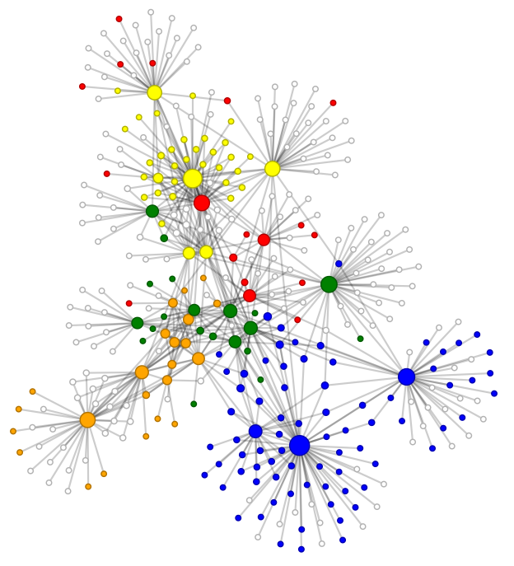
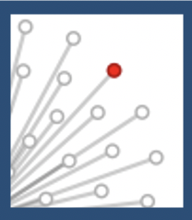
FlashMob: Cache-speed Graph Random Walk
Sample stage
MCKP optimization for partitioning
Shuffle stage
_{Task 2}
Cache-aware
vertex partitions
L1
L2
L3 (LLC)
_{Task 1}
All walkers in partition
DRAM

Slide 19
Evaluation Overview
Evaluation settings
A Dell PowerEdge R740 server with 2 2.60GHz Xeon Gold 6126 processors
12 cores and 296GB DRAM per processor
A private 32KB L1 and 1MB L2 caches per core
Baselines
KnightKing [SOSP '19]
GraphVite [WWW '19]
Datasets
Overall result vs. KnightKing
On DeepWalk, 5.4-13.7x speedup
On node2vec, 3.9-19.9x speedup
Performance highlight
KnightKing
FlashMob
Graphs | |V| | |E| | CSR Size
YouTube (YT) | 1.14M | 4.95M | 50.8MB
Twitter (TW) | 41.65M | 1.47B | 11.4GB
Friendster (FS) | 65.61M | 1.81B | 14.2GB
UK-Union (UK) | 131.81M | 5.51B | 42.5GB
YahooWeb (YH) | 720.24M | 6.64B | 57.5GB
Graph datasets (0-degree vertices removed)

Slide 20
Graph Walk/Sampling: Observations and Lessons
Prior work assumed DRAM target scratch space
Memory fast enough, cache not large enough
Random accesses bring poor locality
All proved wrong!
Optimization best as part of walk/sampling engine
Reused by diverse applications
Automatically adaptive to storage hierarchy partitions
L3 Cache
4 ways
DRAM
256GB,
2GB/s BW
NVMe SSD
2TB, 500k IOPS
SATA SSD/HDD
1TB,
1GB/s BW
Network storage
2TB

Slide 21
Case Study 2: Caching and Tiering
Useful in hierarchies
Caching: storing (smaller) hot datasets in faster storage
Tiering: placing datasets across storage layers
Good candidates for building shared software components
Common functionality and goals across data-intensive applications
Limited types of access patterns and popularity distributions
Crucial to performance, sensitive to resource configurations
Easy to show improvement, hard to know where to stop

Slide 22
Related Study 3: New Challenges for Memory Caching
Faster storage devices
Previous: significant performance gap between memory and block storage devices (1000x)
Ultra-low latency NVMe SSDs reduce latency gap to 10x
Higher concurrency
Contentious accesses to shared data structures due to cache management
Originally read-heavy user accesses become write-intensive due to cache metadata update
Hit latency $(μs)$
Number of threads

Slide 23
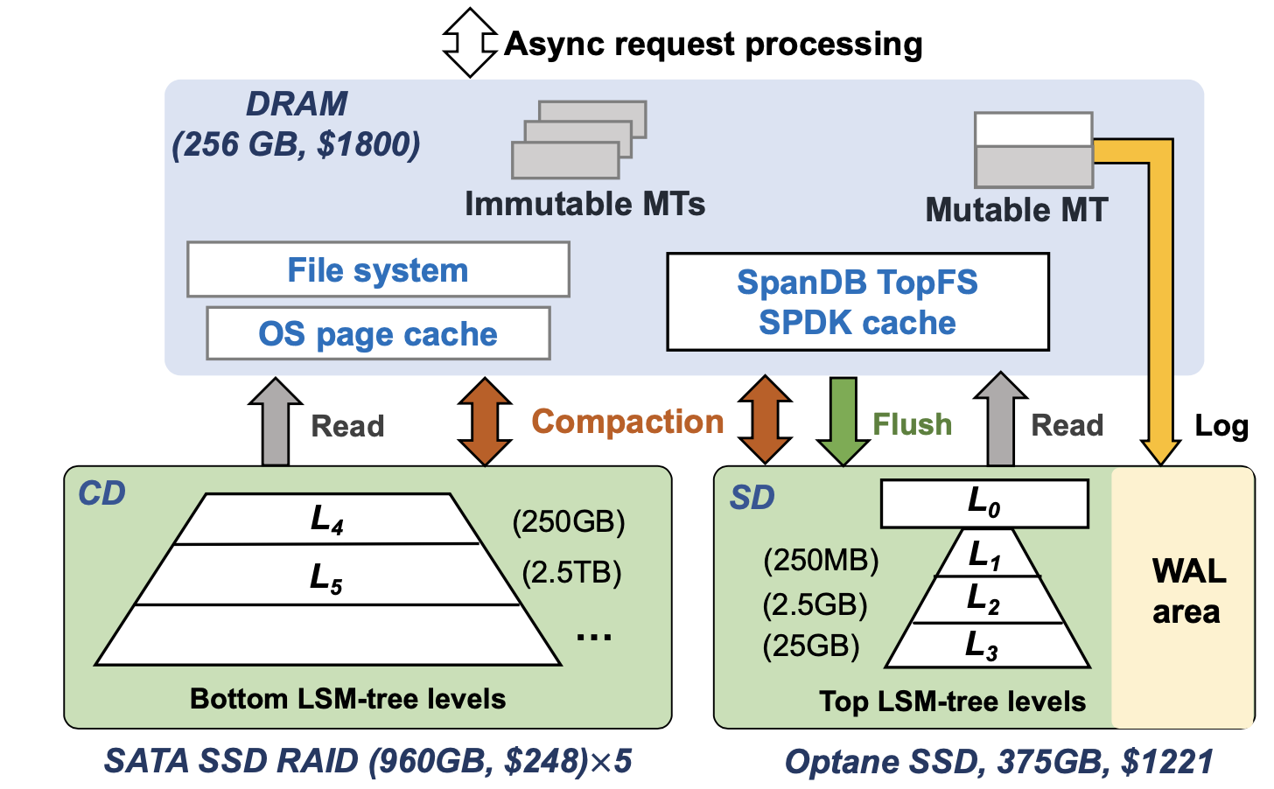
Related study 4: Data Placement Across Heterogeneous SSDs
SpanDB [FAST 2021], w. USTC
Implemented within RocksDB
Distributing LSM-tree based KV data
Large and slow disk for capacity
Small and fast disk for speed
Automatic tree layer placement
Adaptive to partition sizes and workloads
Allow hybrid storage for cost-effectiveness
NVMe SSD
500GB, 1M IOPS, 2GB/s BW
2TB, 500k IOPS
NVMe SSD
5TB, 3GB/s BW
SATA SSD

Slide 24
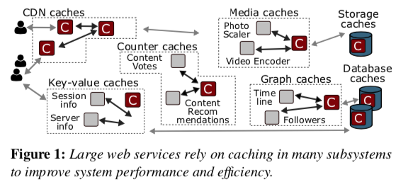
Effort Toward Shared Caching Component
CacheLib (CMU, Meta, MSR) [OSDI ’20]
Caching plays similar roles across companies: Amazon, Twitter, Reddit, …
Different types of caches, able to use “common core of features” and share performance optimizations
Getting adopted
By increasing number of Facebook services
Partially open-sourced, as pluggable, in-process caching engine in C++
(Source: CacheLib paper [OSDI ’20])

Slide 25
Closing Remarks
Applications run on shared hardware resources
Hardware designed for multi-tenancy
Low-level system software too
End-to-end resource partitioning across storage hierarchy enabled
We need high-performance shared software components
Avoid repetitive development/tuning cost
Consolidate advanced, reusable optimizations
Encourage resource-adaptive design
Thank you!

Slide 26
Handling High-Degree Vertices
high degree vertices: pre-sampling (PS)
Cache-friendly batched edge sampling
Many walkers consume pre-sampled edges sequentially
Vertex partition containing few vertices
High degree,
few vertices
v_{H}
v_{H}
V
(sorted by degree)
Next sample edge
…
…
Pre-sampling
Pre-sampled edge buffer
Extra round of computation, but worthwhile
Pre-sampling stage: one vertex at a time (edge list fits into cache)
Walk stage: streaming-only, little wasted cacheline content
Edge list

Slide 27
Handling Low-Degree Vertices
Low degree vertices: direct sampling (DS)
Many vertices share common degree
Vertex partition containing many vertices
Random accesses, but in small partition
V
(sorted by degree)
v_{L}
Packed edge list
(Partition of 2-edge vertices)
Slower memory accesses, but fewer of them
Single-stage process: no pre-sampling stage
Uniform-degree partitions: no degree lookup
Compact edge storage: more vertices in cache

