Slide 1
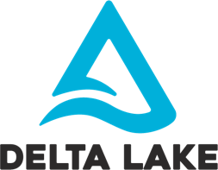
Delta Lake
One storage for all your data analytics
Tathagata Das
Staff Engineer – Databricks
CDMS Workshop 2022

Slide 2
About Me
Developing for last 11 years since grad school in AMPLab, UC Berkeley
Developed Spark Streaming, and Spark Structured Streaming
Developing Delta Lake for last 4 years
Author of ”Learning Spark, Second Edition”

Slide 3
Data Management Systems

Slide 4
Data Warehouses
High quality, reliable data
Great for Business Intelligence
Only structured data
Closed, proprietary formats
No support for data science, ML, streaming
Expensive to scale out
BI
Reports
Data Warehouses
ETL
External Data
Operational Data

Slide 5
Data Lakes
Open formats
Cheap to scale
All data types and use cases
Poor data quality and transactional guarantees
Complex to manage and govern
Unreliable data swamps
Data Science
Machine Learning
Real-Time Database
Reports
BI
Data Prep and Validation
ETL
Data Warehouses
Data Lake
Structured, Semi-Structured and Unstructured Data
Notes:
This is what led to Data Lakes - which is open, offers scalability and flexibility, AND can handle all data types for Data Science and ML
But, they have low quality data due to the lack of transactionality and lack of schema enforcement.
And as a result of that, the data turns into unreliable data swamps,
where you have all the data, but it’s very difficult to make any sense of it.

Slide 6
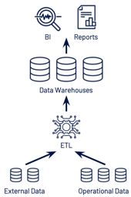
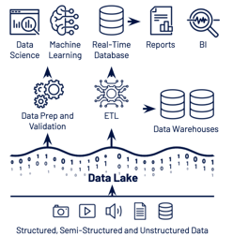
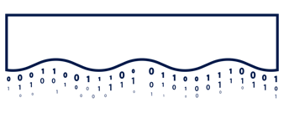
Lakehouses – Best of Data Warehouses + Data Lakes
Data Warehouse
Data Lake
Streaming Analytics
BI
Data Science
Machine Learning
Structured, Semi-Structured and Unstructured Data
Notes:
This is why, we have Lakehouses today, which is best of both worlds
it is basically a portmanteau of data lakes and data warehouses.

Slide 7
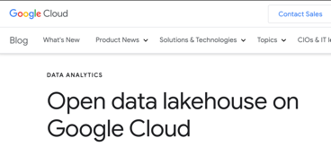
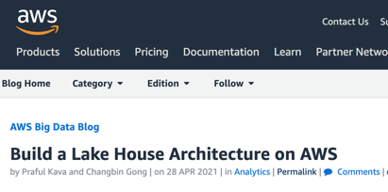
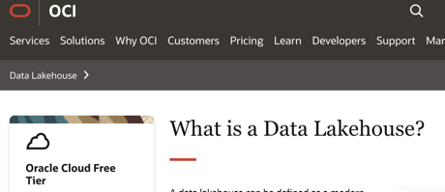
Lakehouse Architecture being adopted everywhere
Notes:
These were all built on open source projects like Spark, Flink,, etc. the projects that allowed massive data workloads to be processed very fast at scale.
Finally, all of this comes together in the form of Lakehouse,
where you’ve dramatically simplified your data architecture and unlocked whole new world for mission critical Machine Learning , Streaming and AI use cases,

Slide 8
Lakehouse Architecture
One platform for all Data use cases
Streaming Analytics
BI
Data Science
Machine Learning
Structured transactional layer
Scalable, low-cost directly accessible Cloud Data Lakes
Structured, Semi-Structured and Unstructured Data
Notes:
This is how Lakehouse architecture looks like
It is based on low- cost and directly-accessible cloud data lakes.
So you are able to have all of your data, structured and unstructured, in one place.

Slide 9
Lakehouse Architecture
One platform for all Data Use Cases
Streaming Analytics
BI
Data Science
Machine Learning
Open, Transactional Layer for Curated Data
Scalable, low-cost directly accessible Cloud Data Lakes
Structured, Semi-Structured and Unstructured Data
Notes:
It brings reliability and quality on top of it without leaving the lake, with an open data storage format called Delta Lake, which is a Linux Foundation project
It offers ACID transactions and schema enforcement, allowing you to overcome a lot of the challenges that data lakes have historically presented.
Transition
Moreover, these formats that were built to solve data reliability problems exist because…

Slide 10
Lakehouse Architecture
One platform for all Data Use Cases
Streaming Analytics
BI
Data Science
Machine Learning
High perf query engine(s)
Open, Transactional Layer for Curated Data
Scalable, low-cost directly accessible Cloud Data Lakes
Structured, Semi-Structured and Unstructured Data

Slide 11
Delta Lake Architecture
How does it give ACID guarantees of Data Warehouses and scalability of Data Lakes?

Slide 12
Scalable storage
for data
=
+
Scalable transaction log
for metadata

Slide 13
Scalable storage
pathToTable/
+---- 000.parquet
+---- 001.parquet
+---- 002.parquet
+ ...
table data stored as Parquet files on cloud storage
Scalable transaction log
|
+---- _delta_log/
+---- 000.json
+---- 001.json
...
sequence of metadata files to track operations made on files in the table
stored in cloud storage along with table
read and process metadata in parallel

Slide 14
Transaction Log Commits
INSERT actions
Changes to the table are stored as ordered, atomic commits
Each table commit is JSON file in _delta_log with a set of actions
|
+---- _delta_log/
+---- 000.json
+---- 001.json
...
Add 001.parquet
Add 002.parquet
UPDATE actions
Remove 001.parquet
Remove 002.parquet
Add 003.parquet

Slide 15
Consistent Snapshots
INSERT actions
Readers read the log in atomic units thus reading consistent snapshots
|
+---- _delta_log/
+---- 000.json
+---- 001.json
...
Add 001.parquet
Add 002.parquet
UPDATE actions
readers will read
either [001+002].parquet
or 003.parquet
and nothing in-between
Remove 001.parquet
Remove 002.parquet
Add 003.parquet

Slide 16
ACID via Mutual Exclusion on Log Commits
Concurrent writers need to agree on the order of changes (optimistic concurrency control)
New commit files must be created mutually exclusively using storage-specific API guarantees
000.json
001.json
002.json
Writer 1
Writer 2
only one of the writers trying to concurrently write 002.json must succeed

Slide 17
ACID guarantees with very scalable system
Delta relies on scalable cloud storage infra for ACID guarantees
Production-ready as it relies on extremely robust storage systems
Storage systems support
HDFS, Azure, GCS: has built-in mutex
S3: mutex using DynamoDB
000.json
001.json
002.json
Writer 1
Writer 2
only one of the writers trying to concurrently write 002.json must succeed

Slide 18
Scalable Metadata Handling with
Actions in JSON log files automatically checkpointed into Parquet files allowing metadata processing to be scalable using Spark
A single table can manage millions of files with 100+TB of data
|
_delta_log/
+--- 000.json
+--- 001.json
+--- 001.checkpoint.parquet
+--- 002.json
+--- 003.json
distributed processing of parquet + json log files during query planning
Add 001.parquet
Add 002.parquet
Remove 001.parquet
Remove 002.parquet
Add 003.parquet
all actions periodically checkpointed

Slide 19
1+
Exabytes
Processed / day
3K+
Companies Using in Production

Slide 20
Delta Lake Features
What makes it unique?

Slide 21
Delta Lake Key Features
ACID Transactions
Protect your data with serializability, the strongest level of isolation.
Scalable Metadata
Handle petabyte-scale tables with billions of partitions and files at ease
Time Travel
Access/revert to earlier versions of data for audits, rollbacks, or reproduce
Audit History
Delta Lake log all change details providing a full audit trail
Unified Batch/Streaming
Exactly once semantics ingestion + backfill + interactive queries
Schema Evolution / Enforcement
Prevent bad data but allow data to evolve with business needs
Data Constraints and Generated Columns
Ensure data always meets semantic quality requirements
DML Operations
SQL, Scala/Java and Python APIs to merge, update and delete datasets

Slide 22
Data skipping via column stats
Don’t read files unnecessarily!
Column min/max values automatically collected when writing files and stored in Delta Log
Read queries can skip files completely using min/max values
Much better than Parquet row-group filtering as you don’t need to even read Parquet footer
SELECT * FROM events
WHERE year=2020 AND uid=24000
year: min 2018, max 2019 uid: min 12000, max 23000
file1.parquet
skipped as data range outside selected value
file2.parquet
year: min 2018, max 2020 uid: min 12000, max 14000
file3.parquet
year: min 2020, max 2020 uid: min 23000, max 25000

Slide 23
Cluster data with Space Filling Curves
Maximize data skipping!
SELECT * FROM deltaTable WHERE x = 2 OR y = 3
Data skipping most effective when files have very small min/max range
Linear sorting good for one column, not multiple
9 files scanned in total 👎
21 false positives 👎
Linear Order (sorting)
Linear Order (sorting)
0,0
1,0
2,0
3,0
4,0
5,0
6,0
7,0
0,0
1,0
2,0
3,0
4,0
5,0
6,0
7,0
0,1
1,1
2,1
3,1
4,1
5,1
6,1
7,1
0,1
1,1
2,1
3,1
4,1
5,1
6,1
7,1
0,2
1,2
2,2
3,2
4,2
5,2
6,2
7,2
0,2
1,2
2,2
3,2
4,2
5,2
6,2
7,2
0,3
1,3
2,3
3,3
4,3
5,3
6,3
7,3
y=3
0,3
1,3
2,3
3,3
4,3
5,3
6,3
7,3
0,4
1,4
2,4
3,4
4,4
5,4
6,4
7,4
0,4
1,4
2,4
3,4
4,4
5,4
6,4
7,4
0,5
1,5
2,5
3,5
4,5
5,5
6,5
7,5
0,5
1,5
2,5
3,5
4,5
5,5
6,5
7,5
0,6
1,6
2,6
3,6
4,6
5,6
6,6
7,6
0,6
1,6
2,6
3,6
4,6
5,6
6,6
7,6
0,7
1,7
2,7
3,7
4,7
5,7
6,7
7,7
0,7
1,7
2,7
3,7
4,7
5,7
6,7
7,7
x=2

Slide 24
Cluster data with Space Filling Curves
Zorder curvers enables great data skipping in queries with filters over multiple columns
Choose Zorder columns based on query patterns
Re-run zorder if query patterns change
Evolve data layout based on your requirements!
OPTIMIZE deltaTable ZORDER BY (x, y)
7 files scanned in total 👍
13 false positives 👍
Z-Order
Z-Order
0,0
1,0
2,0
3,0
4,0
5,0
6,0
7,0
0,0
1,0
2,0
3,0
4,0
5,0
6,0
7,0
0,1
1,1
2,1
3,1
4,1
5,1
6,1
7,1
0,1
1,1
2,1
3,1
4,1
5,1
6,1
7,1
0,2
1,2
2,2
3,2
4,2
5,2
6,2
7,2
0,2
1,2
2,2
3,2
4,2
5,2
6,2
7,2
0,3
1,3
2,3
3,3
4,3
5,3
6,3
7,3
y=3
0,3
1,3
2,3
3,3
4,3
5,3
6,3
7,3
0,4
1,4
2,4
3,4
4,4
5,4
6,4
7,4
0,4
1,4
2,4
3,4
4,4
5,4
6,4
7,4
0,5
1,5
2,5
3,5
4,5
5,5
6,5
7,5
0,5
1,5
2,5
3,5
4,5
5,5
6,5
7,5
0,6
1,6
2,6
3,6
4,6
5,6
6,6
7,6
0,6
1,6
2,6
3,6
4,6
5,6
6,6
7,6
0,7
1,7
2,7
3,7
4,7
5,7
6,7
7,7
0,7
1,7
2,7
3,7
4,7
5,7
6,7
7,7
x=2
x=2

Slide 25
Data Constraints
Ensure data quality easily
CREATE TABLE people (
firstName STRING,
lastName STRING NOT NULL,
birthDate TIMESTAMP
) USING DELTA;
ALTER TABLE people
ADD CONSTRAINT dateWithinRange
CHECK (birthDate > '1900-01-01’)
ALTER TABLE people
DROP CONSTRAINT dateWithinRange;
Data checks enforced when writing data into Delta table
Specify a Boolean expression that must be true for every row
Writes will fail if these constraints are violated

Slide 26
Automatic Schema Evolution with Merge
Modern problems need modern solutions
Designed for modern CDC workloads that try to bridge semi-structured and structured data
E.g., parse a stream of JSON and write to Delta while automatically including new fields added to JSON
Merge can simultaneously add new column and upsert the changes
Works even with nested columns!
SET spark.databricks.delta.schema.autoMerge.enabled = true
MERGE INTO deltaTable t USING updates u
ON t.key = u.key
WHEN MATCHED THEN UPDATE SET *
WHEN NOT MATCHED THEN INSERT *
updates parsed from JSON
key | value | active
tdas | Tathagata "TD” Das | true
marmbrus | Michael Armbrust | false
updated deltaTable with new column
deltaTable
key | value | active
tdas | Tathagata "TD” Das | true
marmbrus | Michael Armbrust | false
key | value
tdas | Tathagata Das
MERGE

Slide 27
So many more features!
For more information see past talks
Delta 2.0 - https://www.databricks.com/dataaisummit/session/delta-lake-overview
Delta Release Notes - https://github.com/delta-io/delta/releases
Delta Documentation - https://docs.delta.io/latest/index.html
Delta lake: high-performance ACID table storage over cloud object stores
[ VLDB 2020 - https://dl.acm.org/doi/10.14778/3415478.3415560 ]

Slide 28
Delta Lake Community
The best part about Delta!

Slide 29
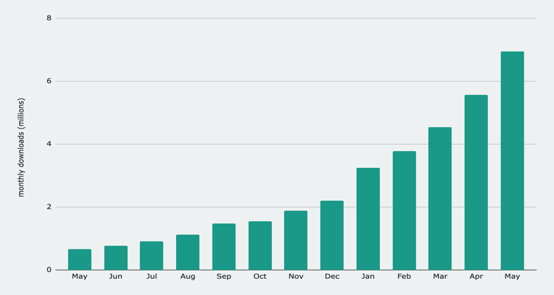
The most widely used lakehouse format in the world
7M Downloads/Month
Delta Sharing 0.4
Delta 1.2
Delta Sharing 0.3
delta.rs
Python 0.5.7
Delta Connectors 0.3
Delta 1.1
Delta Sharing 0.1
Delta Sharing 0.2
delta.rs
Python 0.5
kafka-delta-ingest
0.3
Delta Connectors 0.4
delta.rs 0.4
650K/months
Delta 1.0
2021
2022

Slide 30
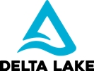
Delta’s expanding ecosystem of connectors
New!
Coming Soon!
Notes:
Ali: Kill the cloud platforms. Highlight the Engines. Delta.io picture is better.
Goal: Talk how ecosystem is evolving and external contributors are adding to it. We see lot of external contribution.
Speak to one connector which we want to highlight (Rust?)

Slide 31
We could not do this without the community!

Slide 32
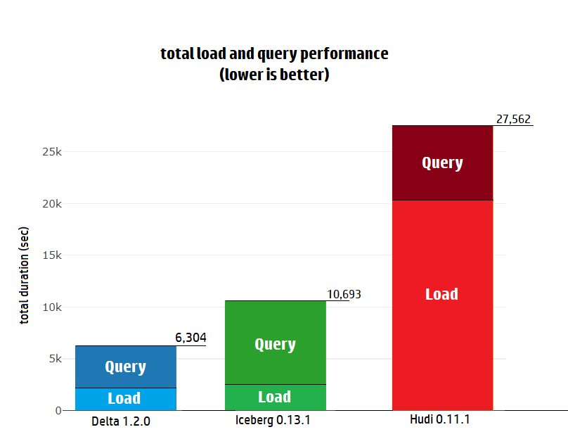
Community Benchmark via Databeans
1.7x faster than Iceberg
4.3x faster than Hudi

Slide 33
Join the community today!
go.delta.io/github
[ 5.2K stars ]
go.delta.io/slack
[ ~7000 members ]
delta.io
go.delta.io/twitter
Notes:
Invite audience to join the community today

Slide 34
The Right Foundation for building Lakehouses
Lakehouse is the new architecture combining the best properties of Data Warehouses and Data Lakes.
Delta Lake is the best storage format with the scalability, ACID guarantees and features needed to build Lakehouses.
Streaming Analytics
BI
Data Science
Machine Learning
Structured, Semi-Structured and Unstructured Data

