Slide 1
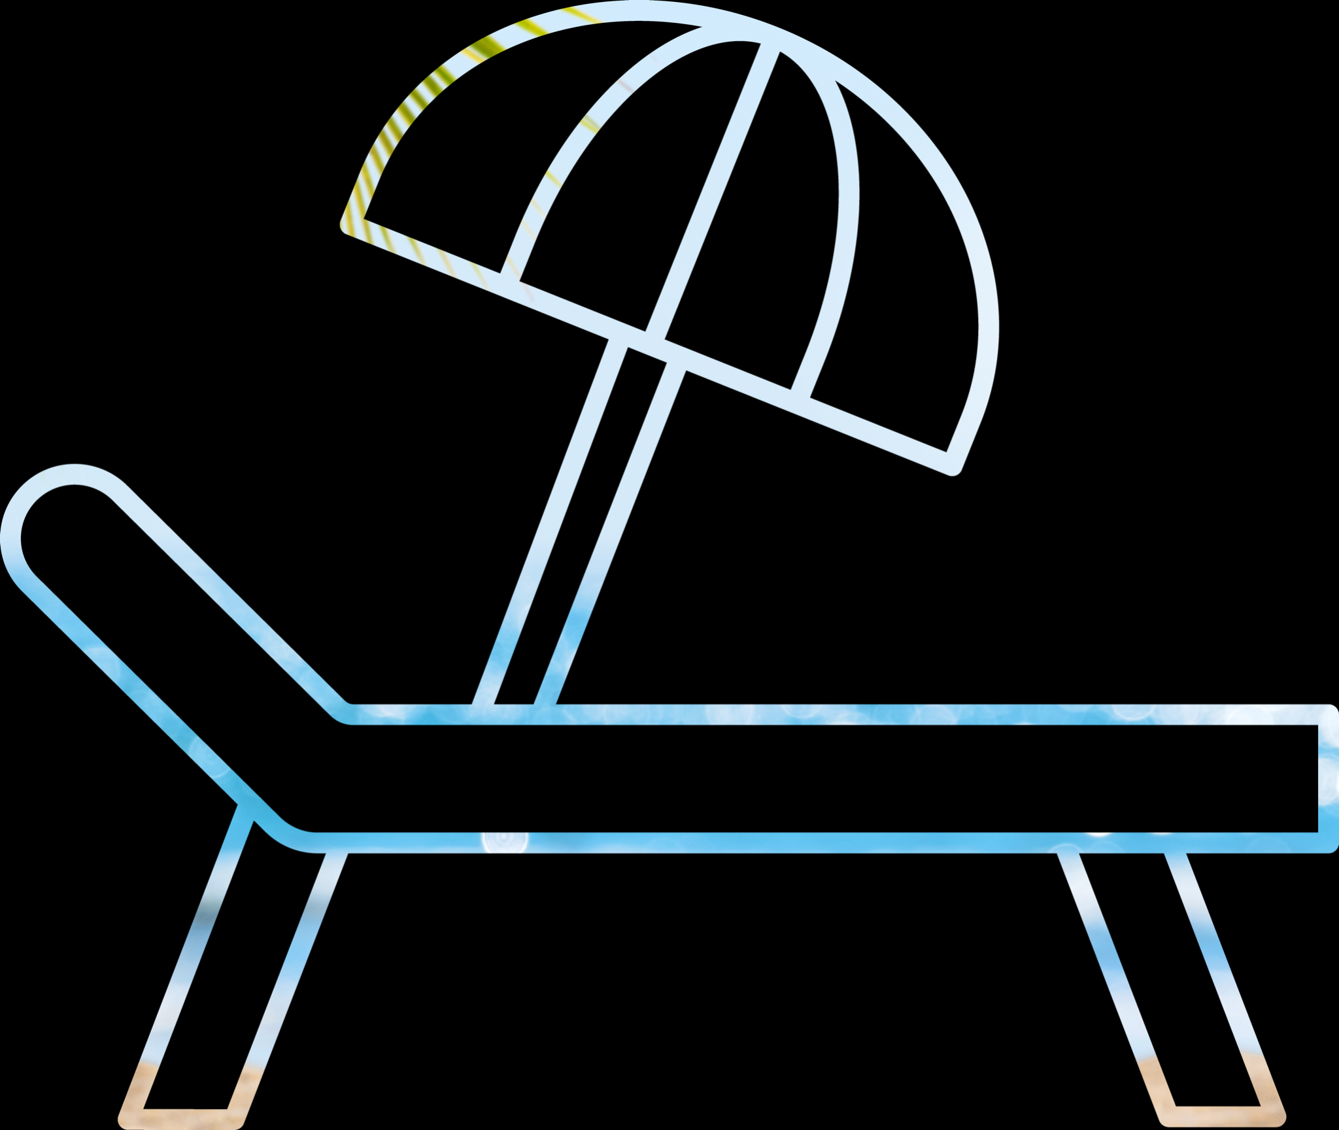
Substrait
Rethinking DBMS Composability
substrait.io

Slide 2
Who?
OSS
Substrait: Co-creator
Apache Arrow: Co-creator, Founding PMC Chair
Apache Calcite: Founding PMC member
Apache Drill: Co-creator, Founding PMC Chair
Commercial
Sundeck: CEO & Co-founder
Dremio: CTO & Co-founder

Slide 3
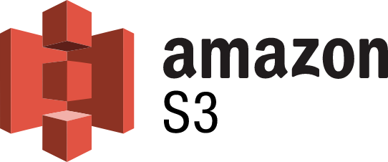
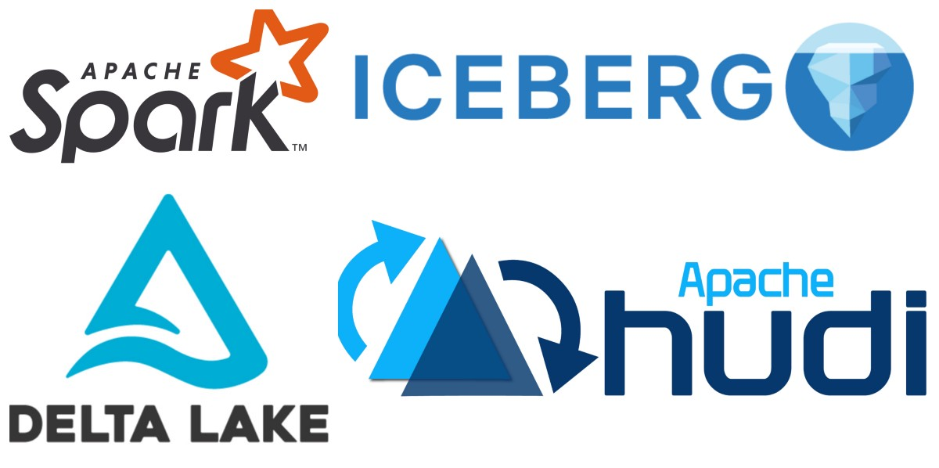
The world has changed
Data lock-in is disappearing
The coupling of API and compute is breaking down
Cloud Storage as System-of-Record
Generic Compute Kernels
Rise of Table Formats
Compute Engine Specialization

Slide 4
Warehouse, Lakehouse, soon we’ll see the Fairhouse
Warehouse Appliance
Cloud Warehouse
Lakehouse
Fairhouse
Query Engines
Spark API/SQL
Dremio SQL
Trino SQL
APIs
Spark API/SQL
Redshift SQL
Trino SQL
Pandas
Ibis
SQL API
SQL API
Spark Engine
Dremio Engine
Trino Engine
Compute Engines
Processing Engine
Processing Engine
Spark Engine
Dremio Engine
Presto Engine
Velox Engine
Arrow Engine
Tables & Catalogs
Apache Iceberg
Apache Hudi
Delta Lake
Storage (internal)
Storage (internal)
Tables & Catalogs
Apache Iceberg
Hudi
Delta Lake
Tabular
Datalake Formation
2000
2015
2020
2025
Specialized hardware
Designed specifically for analytical use
Teradata, Netezza
Built on cloud storage
Unlimited Scale
Snowflake, Redshift
Shared data ownership
API choice independent of storage format
Reduction in data gravity
Databricks, Dremio, Starburst
Rise of the generic engine
Engine options independent of api choice

Slide 5
Best-of-breed Decomposition Requires Components
API
API
Instruction
Data
Engine
actually more like this…
Compiler
Instruction
Engine
Storage
Instruction
Data
Computation
Storage

Slide 6
How to collaborate on these layers?
Substrait
API
Instruction
Data
Compiler
Instruction
Engine
API independent computation definition
Engine independent compilers
Engine independent computational storage
High performance independent in-memory format
In-engine optimized wire-friendly representation
Instruction
Data
Computation
Storage

Slide 7
Inspiration
Abstract Need: Drive Innovation
Concrete Need: Solve Real Problems
Iceberg: Need for a common representation of views
Arrow: Common representation of compute plans across engines
Calcite: expose functionality to non-jvm environments
 | JVM Bytecode | LLVM IR
FE Innovations | Scala, Clojure, Kotlin | Rust, Swift
BE Innovations | Dalvik, Graal | WASM

Slide 8
Substrait: Cross-Language Serialization for Relational Algebra
Status
Formed September 2021
Several integrations ongoing, 30+ contributors from multiple companies
Purpose
Create a well-defined, cross-language specification for data compute operations
Why
New kernels/engines should work with existing analysis experiences
It should be easy to create new computation design languages/platforms
Innovation is stifled when each new data system needs to solve all FE and BE problems

Slide 9
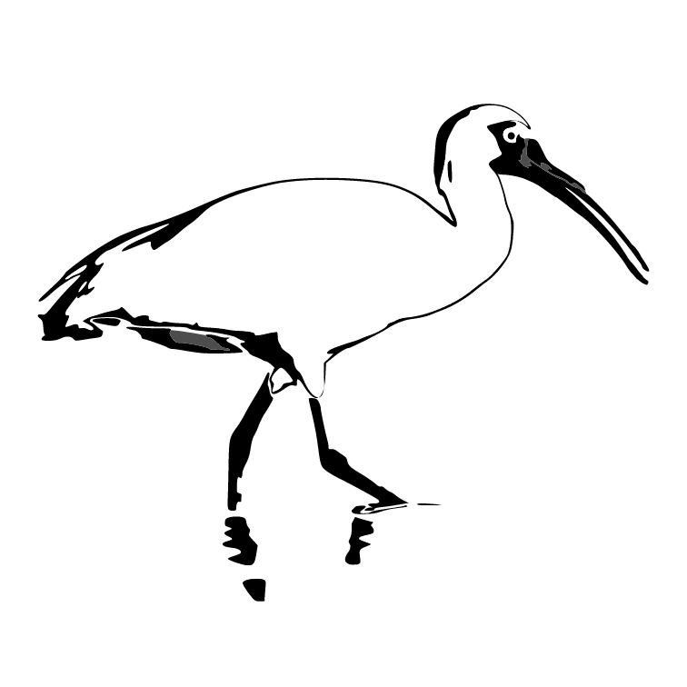
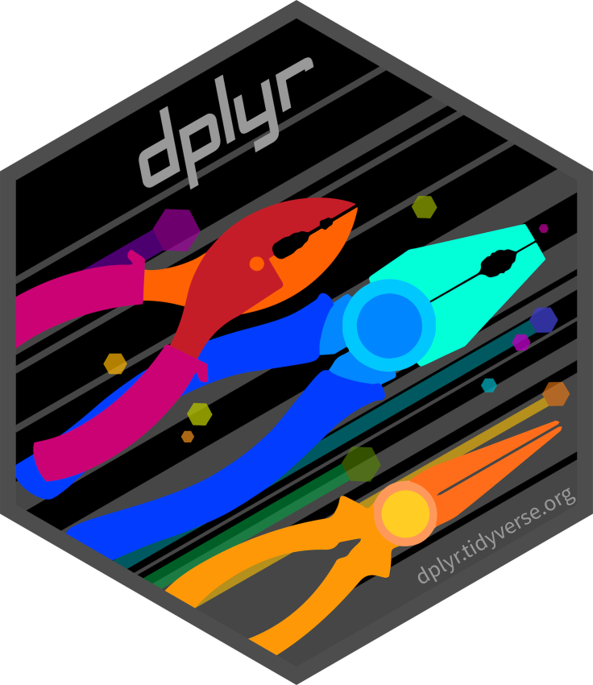
Theoretical Integrations
python
r
babel sql
presto sql
scala
ibis
substrait
views
C++ Kernel

Slide 10
Core Principles
Specification-first
Language independent & serializable
Plans are self-contained, have clear intention
Allow for dumb consumers
Structured hierarchy of primitives
Common primitive definitions within project
Common types, functions, relational operators
Extensibility with discipline

Slide 11
Substrait Primitives
Plan
Types
Simple (e.g. i32, fp32, string)
Compound (e.g. varchar<N>, fixedbinary<N>)
Complex (e.g. List<E>, Map<K,V>, Struct<T,U,...Z>)
Expressions
Switch statements
Field selection (simple and complex)
Literals
Functions
Scalar
Aggregate
Window
Table
Relations
Production
Consumption
Distribution
Transformation
Plans
Splittable
Normalized for space efficiency
Serialization
Binary (currently protobuf)
Text (tbd, likely yaml)
Types
Expressions
i8
i32
case
field
fp32
struct
literal
orlist
Relations
Functions
join
agg
add
avg
filter
read
rank
sum
Serialization
protobuf
text

Slide 12
Extensibility with Discipline
Project inclusive of patterns that show up in most projects
int32, decimal, add, subtract, aggregate, join, hash join, etc.
Specification defined extensibility
Separation between optimization and semantic differences
Well-defined ways to sync independent systems around extensions
Types
Support for physical variations of existing types (row-wise vs columnar, rle or not, etc)
Declare custom types in YAML and use in functions, expressions, etc.
Functions
Declare custom functions via YAML, standard referencing scheme
User-defined functions (write once, use many times)
Embedded (business logic closure in scala, python, llvm, webassembly)
Relations
Extend existing relations for execution optimization information
Declare new relations via serialization extensions (such as protobuf
User-defined and Embedded patterns

Slide 13
Project Governance
Guiding Principles
Consensus-driven project
All collaboration and decision-making is done in the public
Avoid control by any particular organization or person
Users of Substrait should be confident that the project won't one day "change its stripes" like Redis, Confluent or various other projects did.
Details
Apache 2.0 Licensed
Github Project
Active contributions from several companies
Move to a foundation if contributors so prefer

Slide 14
Core Components
Specification/Format
github.com/substrait-io/substrait
Language specific helper libraries (Java, C++, C#, Go, Rust)
github.com/substrait-io/substrait-*
Plan Validator
github.com/substrait-io/substrait-validator
Integration Tests
github.com/substrait-io/consumer-testing
Network Protocol (On top of Arrow Flight SQL)
github.com/apache/arrow/pull/13492
Integations
Next page…

Slide 15
Theoretical Integrations
python
r
babel sql
presto sql
scala
ibis
substrait
views
C++ Kernel

Slide 16
Actual Implementations
python
r
babel sql
presto sql
scala
1: bit.ly/3AyLsP9
2: bit.ly/3AC6jku
3: bit.ly/3TrY3wh
4: bit.ly/3pTi2q3
5: bit.ly/3TuySck
6: bit.ly/3R1CFwl
7: bit.ly/3AUNH0G
ibis
1
2
3
4
substrait
views
5
4
6
7
C++ Kernel

Slide 17
Join the Community
Start using Substrait
Join the community
Share your feedback
Substrait Slack
Subscribe
Github
Start a discussion
Open an issue
Submit a PR

